Slide 1
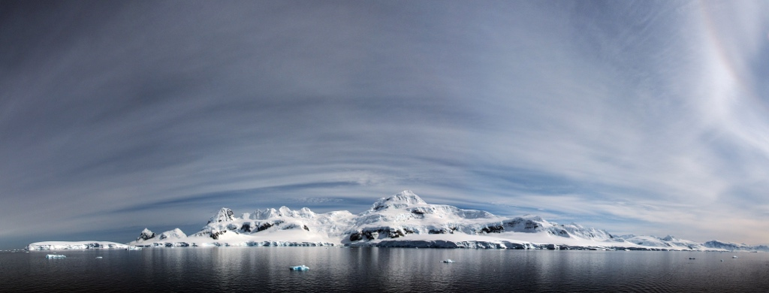
Spatiotemporal variability in Adélie penguin demographic rates from opportunistic point count data
Heather J. Lynch¹, Elise Zipkin², Michael Schaub³
¹Stony Brook University, ²Michigan State University, ³Swiss Ornithological Institute

Slide 2
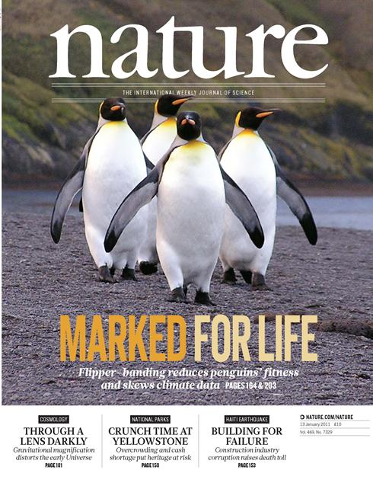
Mark and recapture of animals is the gold standard for estimating demographic transition rates (survival, fecundity, etc.)
but…
marking animals is not always
(1) technically possible,
(2) ethical, or
(3) a reliable method of inferring survivorship
[if marking affects mortality]

Slide 3
Can we infer demographic rates from counts of unmarked individuals?

Slide 4
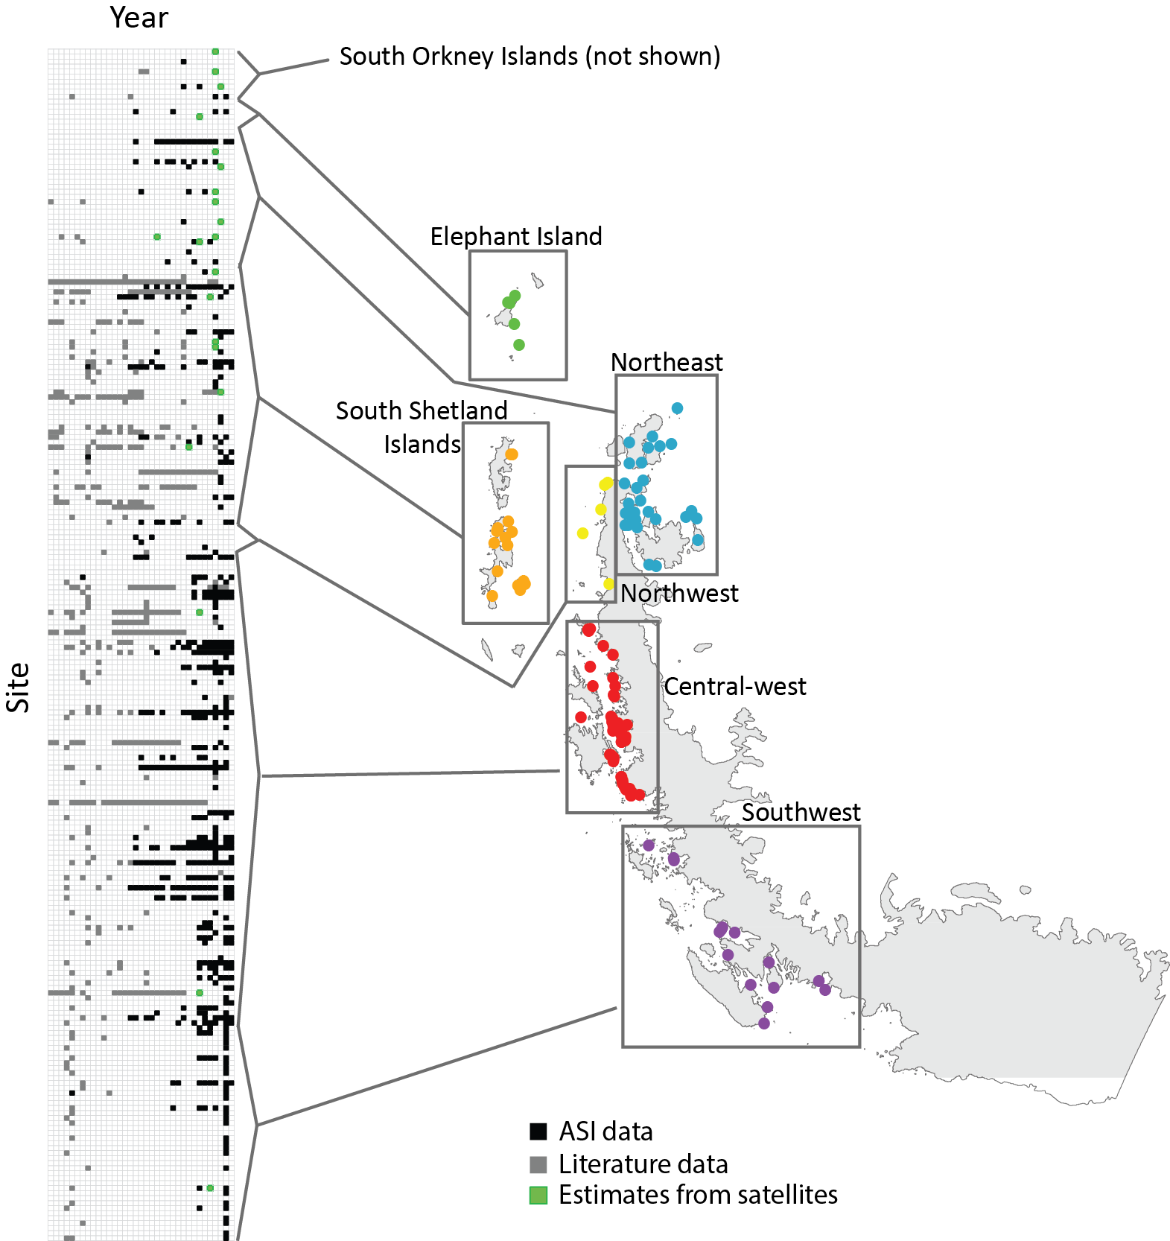
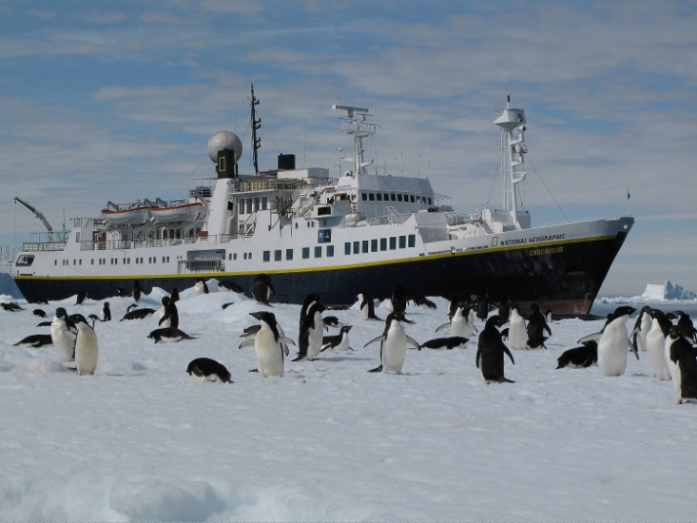
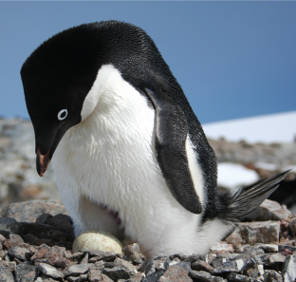
1979
2014
Model presented today includes a sub-set of these data, focusing on the longest, most complete time series available for Adélie penguins.
Photo: Thomas Mueller
Antarctic Site Inventory
(1994-present)
>200 sites surveyed
Adélie penguin (Pygoscelis adeliae)

Slide 5
Question:
Can we use patchy point counts to parameterize a state-space model to estimate demographic rates (specifically, spatial and temporal variation in demographic rates) and thereby reduce or even eliminate the need for mark-recapture of penguins?

Slide 6
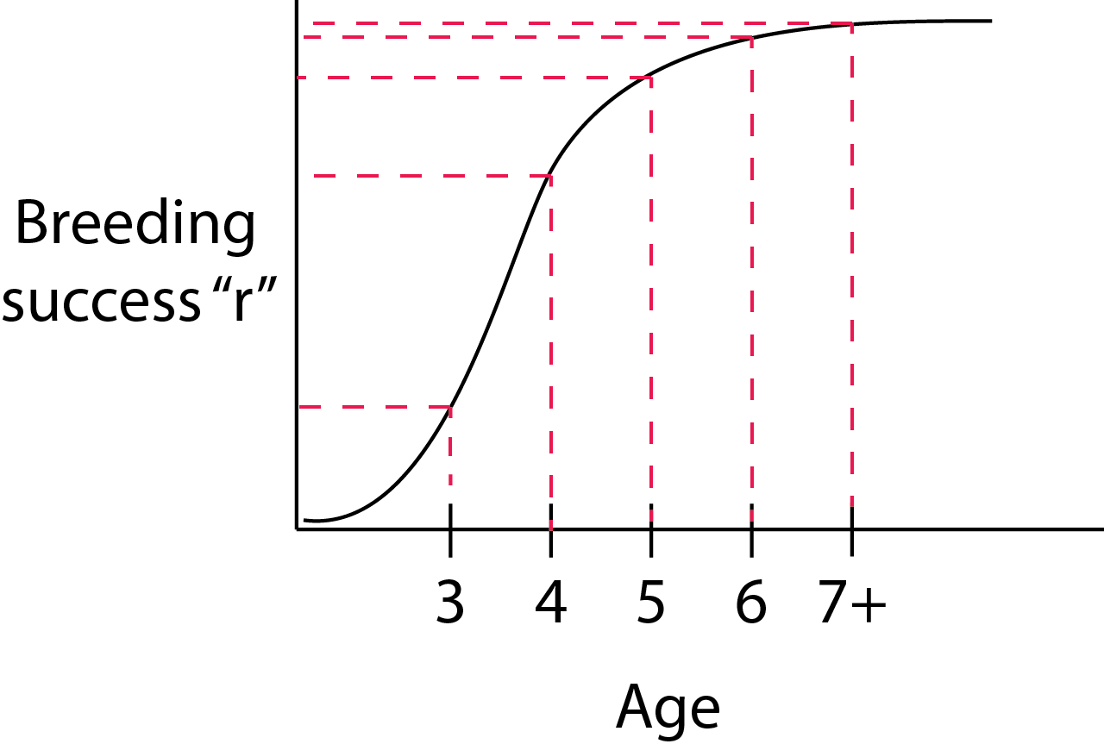
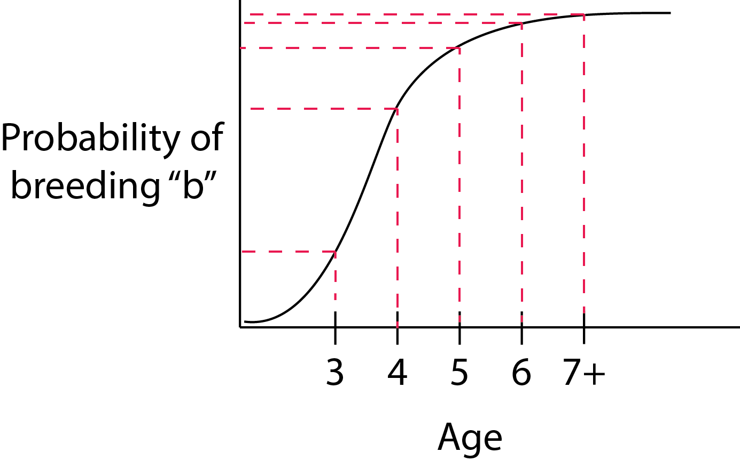
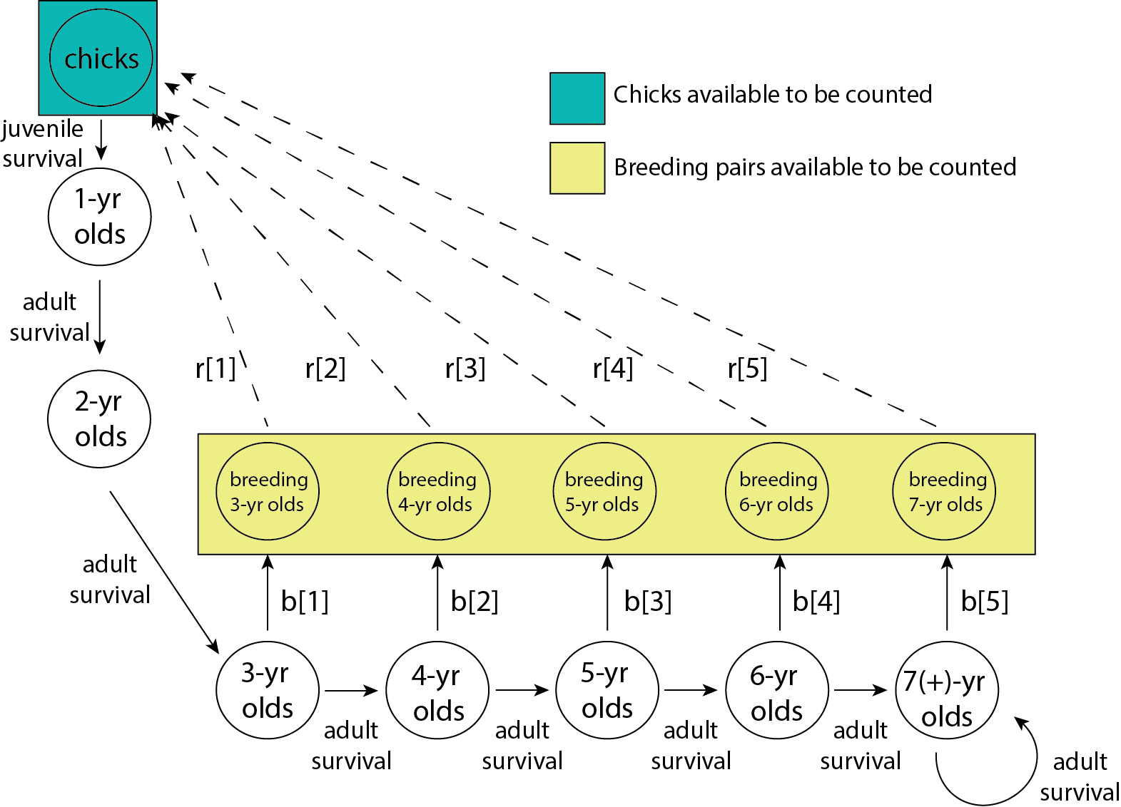
- Zipkin et al. (2014) develop multistate open metapopulation models with detection error
- Here we have only partial state information (most states are unmeasurable latent states) but the population is closed.
5 parameters ➤ 2 parameters
Adélie penguin (Pygoscelis adeliae)

Slide 7
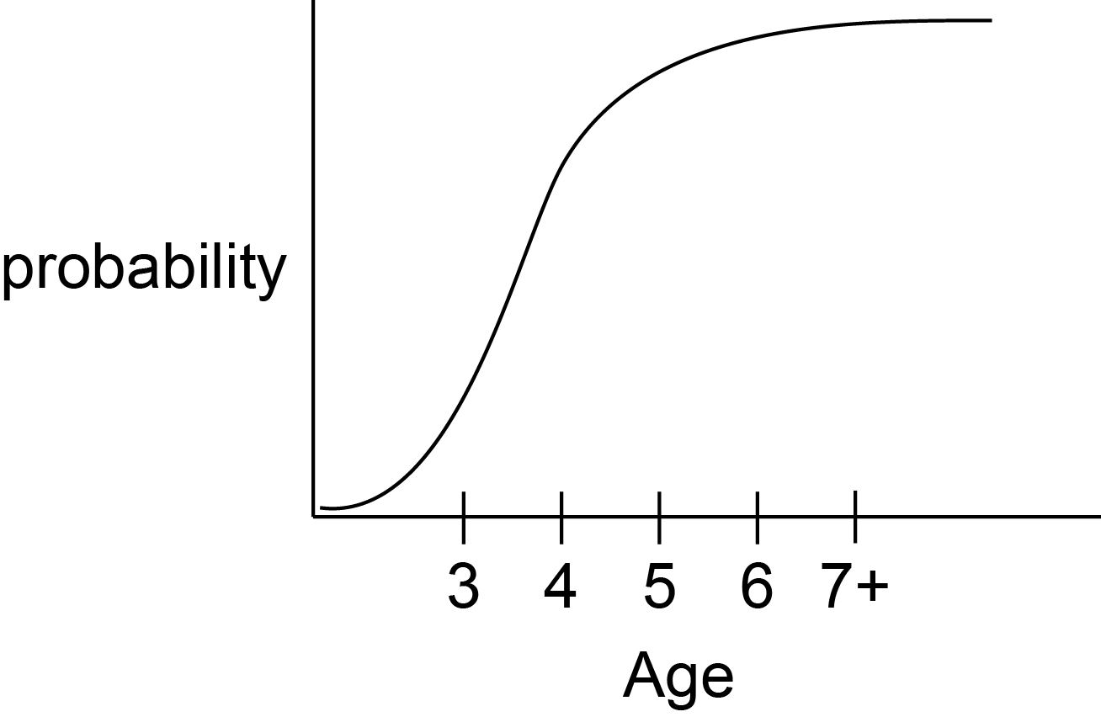
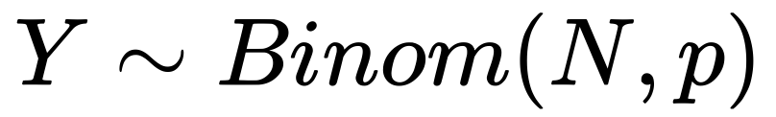
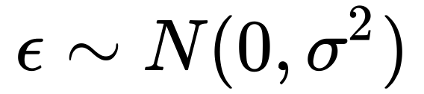
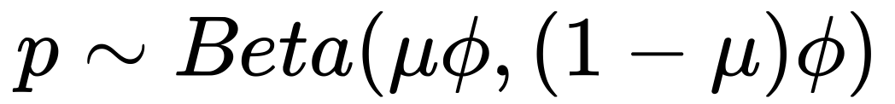
Side note: process error on a probability
1
Year t+1
Year t
0

Slide 8
Available data on Adélie penguins
(most complete time series available)
Antarctica
Region | # Populations | # Nest counts (1979-2014) | # Chick counts (1979-2014)
S. Shetland Islands | 6 | 93 | 6
Northeast Peninsula | 1 | 2 | 7
Central-west Peninsula | 9 | 115 | 49
Southwest Peninsula | 2 | 8 | 10
Ross Sea✦ | 2 | 55 | 0
Declining
Stable
Declining
Declining
Stable/Increasing
✦ Lyver et al. Unpublished

Slide 9
How do we fit the models?
Bayesian methods provide a straightforward way to incorporate prior information
mark-recapture
studies
Do the models “work”?
“In passing it might be noted that unidentifiability causes no real difficulty in the Bayesian approach” (Lindley 1972)
The question is what we can learn from the point counts about spatiotemporal variability in demographic rates

Slide 10
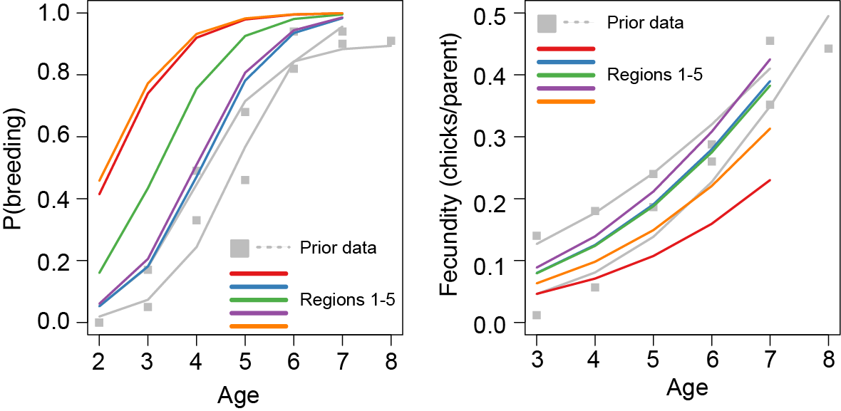
Results
All regions start with the same ‘prior’, but the point count data provides some information on differences in demographic rates between regions.
Antarctica

Slide 11
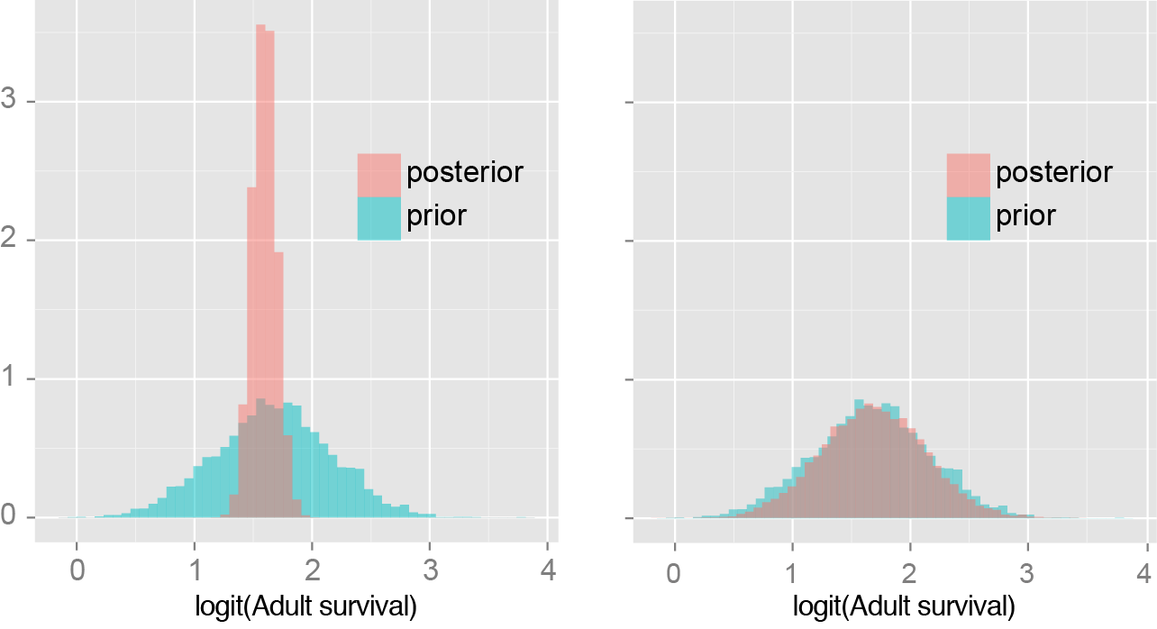
How do we measure whether the abundance data has added anything new?
S. Shetland Islands
(data rich)
Adult
survivorship
Northeast Peninsula
(data poor)
34.6% overlap
97.0% overlap

Slide 12

How do we measure whether the abundance data has added anything new?
S. Shetland Islands
(data rich)
Adult
survivorship
Central-west Peninsula
(data rich)
34.6% overlap
97.0% overlap

Slide 13
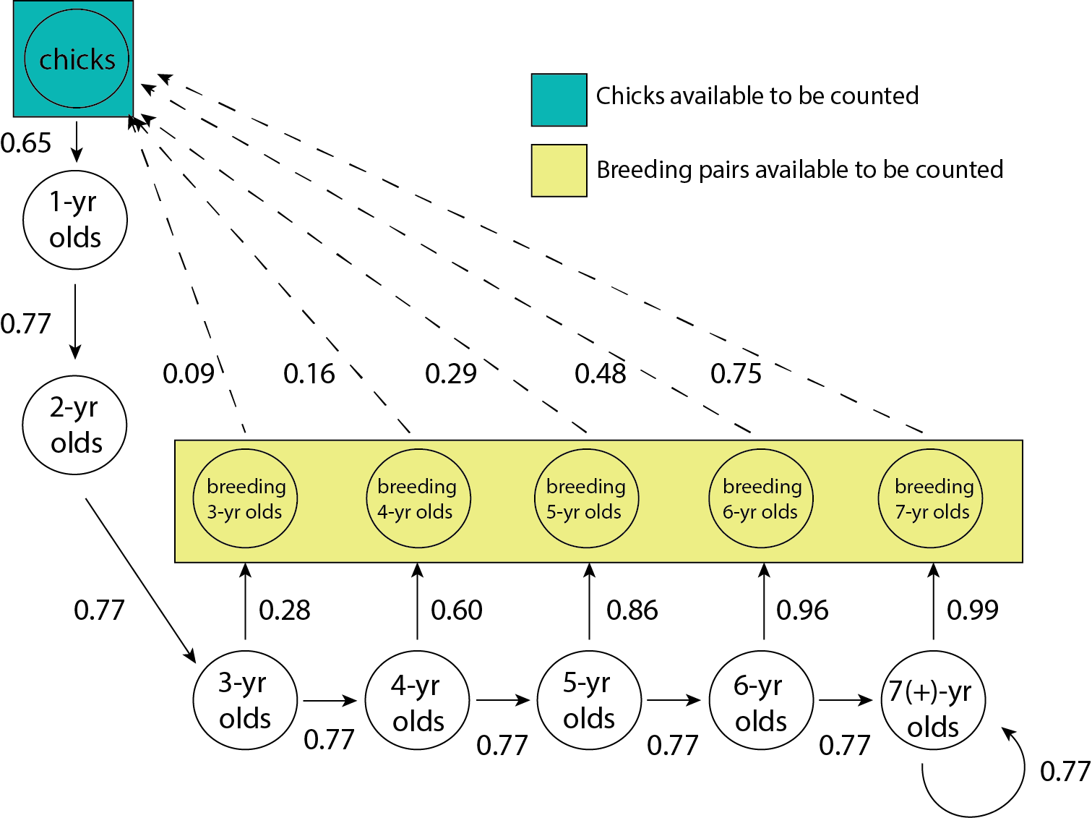
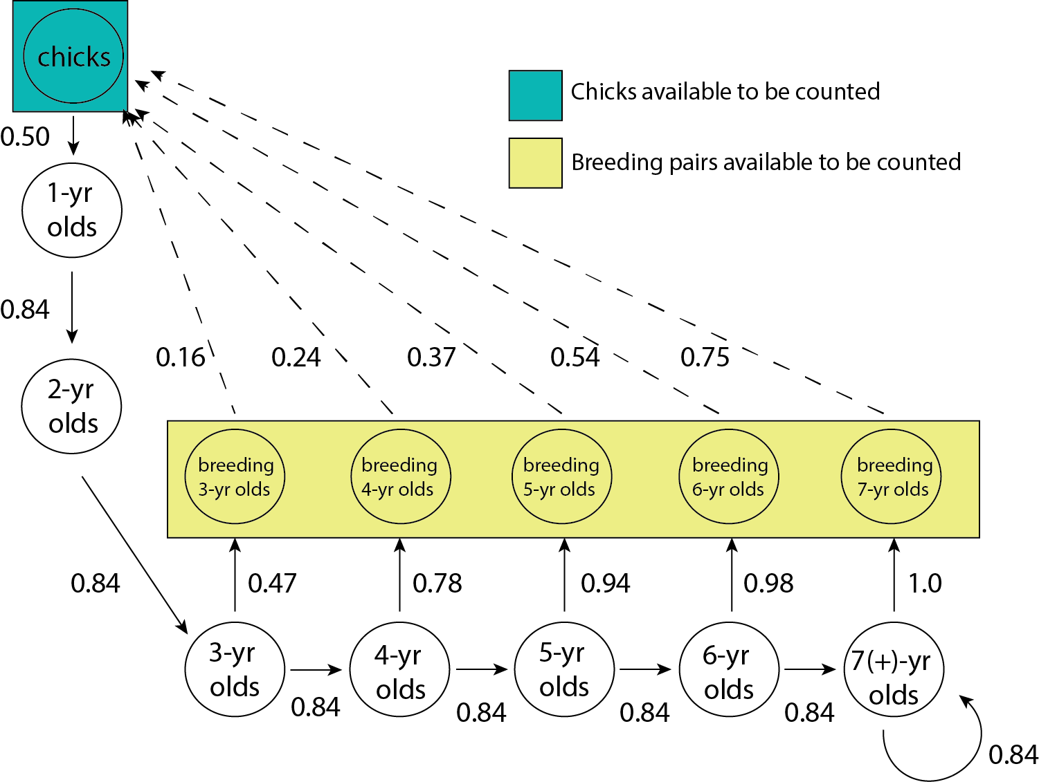
Region | # Populations | # Nest counts (1979-2014) | # Chick counts (1979-2014)
S. Shetland Islands | 6 | 93 | 6
Central-west Peninsula | 9 | 115 | 49
*
*
*
*
*
Antarctica
*
*
*
*
*
*
*
Reproductive rates appear very hard to estimate, but these are the easiest data to get using camera traps and don’t require mark-recapture
*
*
*
*
*
*

Slide 14
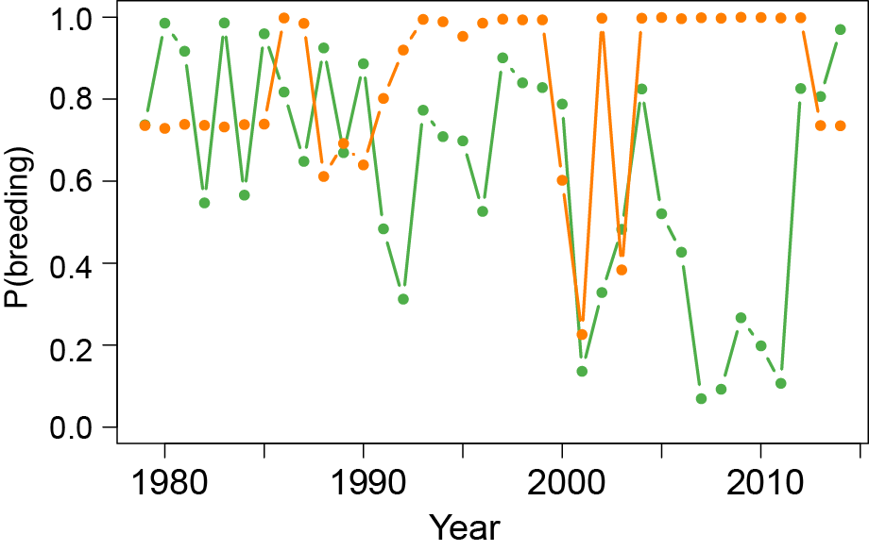
Interannual variation in breeding probability
Antarctica
Consistently high probability of skipped breeding in the Central-west AP

Slide 15
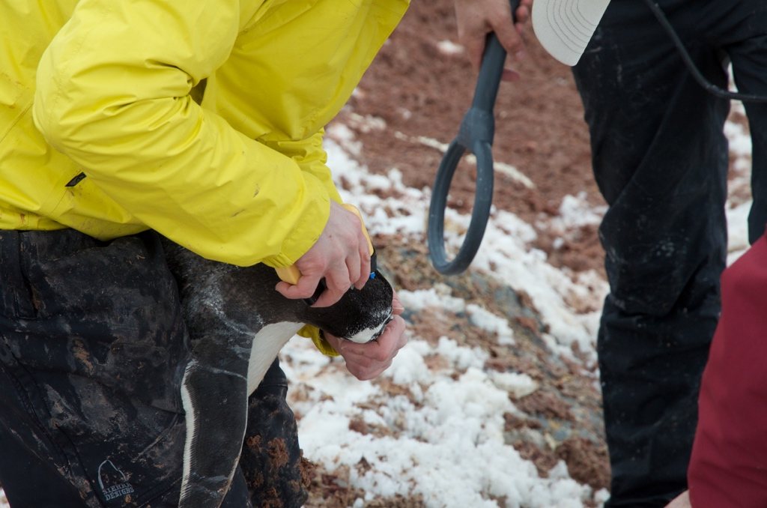
Conclusions & Future directions (statistical)
State-space models for unmarked individuals don’t require count data on every stage, but data requirements aren’t well understood
Need to think about tools for quantifying the influence of prior and data
Abundance data is relatively cheap, but you need much more of it to infer demographic transition rates in the absence of mark-recapture data

Slide 16
Conclusions & Future directions (ecological)
Var[adult survival] < Var[juvenile survival]
< Var[breeding propensity] < Var[fecundity]
Breeding propensity easiest demographic parameter to estimate using point count data
Search “data space” using simulations ➤ determine the kinds of data needed to estimate demographic rates
Next steps: Add (positive and negative) density-dependence
Next steps: Add rare dispersal of individuals among populations
(closed population models ➤ open metapopulation models)

Slide 17


Questions?
Thanks to:
My lab
Oceanites, Inc.
Funding:
USGS John Wesley Powell Center for Analysis and Synthesis
US National Science Foundation Office of Polar Programs (NSF/OPP-1255058 and 1341474)
the National Air and Space Administration (NASA NNX14AC32G).
For more information:
www.lynchlab.com

